Slide 1

INTERACTIVE DASHBOARD FOR
REVENUE AID BOOKING
PERFORMANCE
Github Repository
Zamin Mammadov

Slide 2
Business Objective
AtliQ operates a portfolio of hotels across multiple cities in India.
To improve revenue visibility and performance tracking, leadership needed a single, reliable reporting view instead of scattered manual analysis.
Using booking data from May to July 2022, this project delivers a Power BI KPI dashboard that monitors revenue and key metrics across hotel type, city, property, and booking channel.
The dashboard helps management quickly identify trends, understand the main revenue drivers, and take data-driven actions to improve performance.

Slide 3
Problem statement
AtliQ Grands needs a single, reliable dashboard to monitor hotel revenue performance and quickly understand what is driving changes (demand, pricing, cancellations, and channel mix) across cities and properties.
Project scope
Combine revenue-related data needed for analysis (bookings + room-night metrics).
Clean and transform the dataset to remove inconsistencies and ensure accurate KPIs.
Build a Power BI data model and define the key measures for performance tracking.
Create an interactive KPI dashboard with slicers for time, city, property, hotel type, and booking platform.
Provide both an executive overview and drill-down views to identify top/bottom performers and revenue leakage areas.

Slide 4
Solution Approach (Slide)
Used the provided hotel dataset covering May–July 2022 (W19–W31), built around booking-level and room-night information.
Prepared the data in Power Query (data type fixes, cleaning, and transformations) to make it ready for reporting.
Designed a clean data model by connecting the fact tables with the supporting dimension tables (date, hotel, room, platform/segment fields) so slicers work correctly.
Created key DAX measures for revenue and performance tracking (revenue, occupancy, average daily rate, revenue per available room, realisation, cancellations, booked vs utilised nights).
Built an interactive Power BI dashboard with drill-down views to analyze trends, hotel type mix (Business vs Luxury), weekday vs weekend patterns, platform performance, and top/bottom hotels.

Slide 5
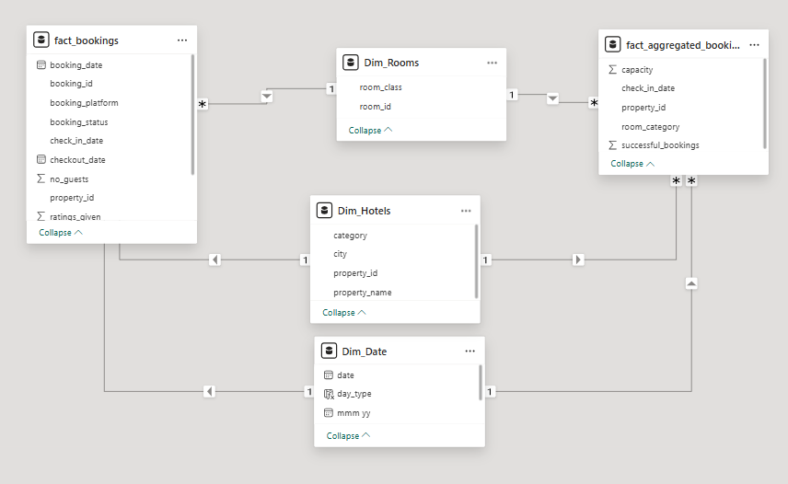
Data modelling (Power BI – Model view)

Slide 6
Solution Approach — KPI Measures
A set of DAX measures was created in Power BI to calculate the key performance indicators:
Total Revenue = Sum of realised revenue from the Bookings table
Total Bookings = Count of booking IDs from the Bookings table
Average Rating = Average of guest ratings from the Bookings table
Booked Room Nights = Sum of booked room nights from the Aggregated Bookings table
Utilised Room Nights = Sum of utilised (stayed) room nights from the Aggregated Bookings table
Cancellation Rate = Cancellations ÷ Total Bookings
Occupancy Rate = Utilised Room Nights ÷ Total Capacity (available room nights)
Average Daily Rate = Total Revenue ÷ Utilised Room Nights
Revenue per Available Room = Total Revenue ÷ Total Capacity
Realisation Rate = Utilised Room Nights ÷ Booked Room Nights

Slide 7
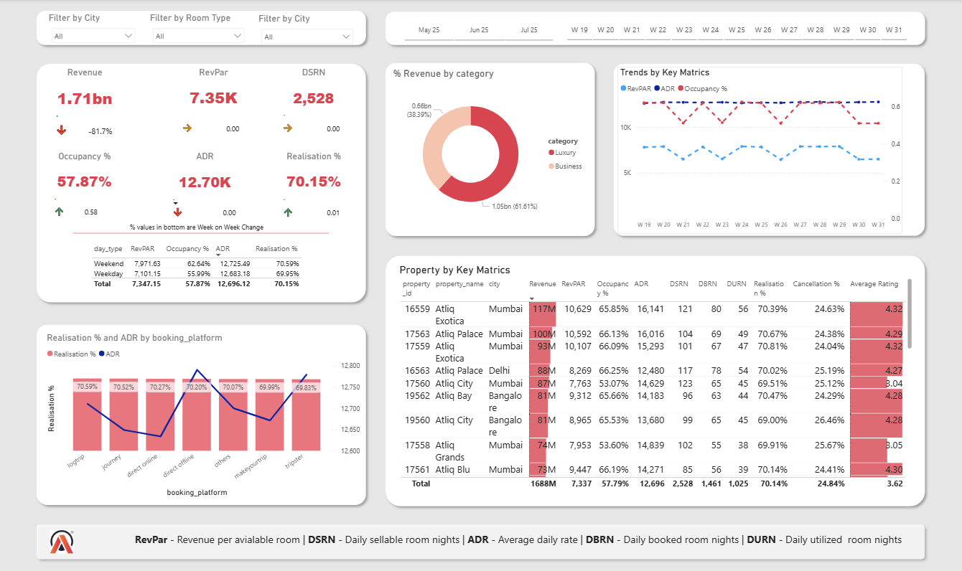
Dashboard Overview (AtliQ Grands)

Slide 8
Features of the Dashboard (based on your README)
The dashboard presents an executive overview of performance using KPI cards for:
Total Revenue, Revenue per available room, Occupancy %, Average daily rate, Realisation %, and Total sellable room nights.
Interactive slicers allow users to filter results by key dimensions such as:
City, Room Type, Property/Hotel, Booking Platform, and the selected time period (week/month range).
The dashboard supports both high-level monitoring and drill-down analysis, helping identify where revenue is earned and where leakage happens.
Visuals are fully interactive (cross-filtering between charts), with hover tooltips for quick additional detail on each data point.

Slide 9
Main visuals included to support analysis:
  Revenue mix by hotel type (Business vs Luxury) to understand segment contribution.
  Weekly trends of key metrics to track changes over time and identify dips/spikes.
  Weekday vs weekend comparison to evaluate demand patterns and pricing opportunities.
  Platform performance view comparing booking platforms using Realisation % (and pricing) to support channel strategy.
  Property performance matrix showing KPIs by hotel and city to quickly spot top and bottom performers (with cancellations and ratings for context).

Slide 10
Business Outcomes
Portfolio performance (W19–W31, 2022): AtliQ Grands generated 1.71bn in revenue with 57.87% occupancy, 12.70K average daily rate, and 70.15% realisation.
Revenue mix insight: Revenue is mainly driven by the Luxury segment (1.05bn, 61.61%), while Business contributes 0.66bn (38.39%). Protecting Luxury availability, pricing, and guest experience has the biggest impact on total revenue.
Main driver of performance: Occupancy fluctuates more than room price across the weeks, and changes in occupancy align with changes in revenue per available room. This suggests the strongest lever is improving utilised room nights, not frequent price changes.
Demand pattern: Weekends perform better than weekdays (higher occupancy and higher revenue per available room), while room price stays almost the same. This indicates a clear opportunity to lift weekday demand without damaging pricing.
Revenue leakage risk: Realisation stays around ~70% and the cancellation rate is high (~24.84%), meaning a large share of booked nights is not converted into utilised nights. Reducing cancellations/no-shows can directly increase realised revenue.
Property-level differences: Top hotels (especially in Mumbai) achieve strong results by combining high occupancy and premium room price, while some properties have good pricing but weaker occupancy, and low ratings are a warning signal for future cancellations and demand.

